Slide 1
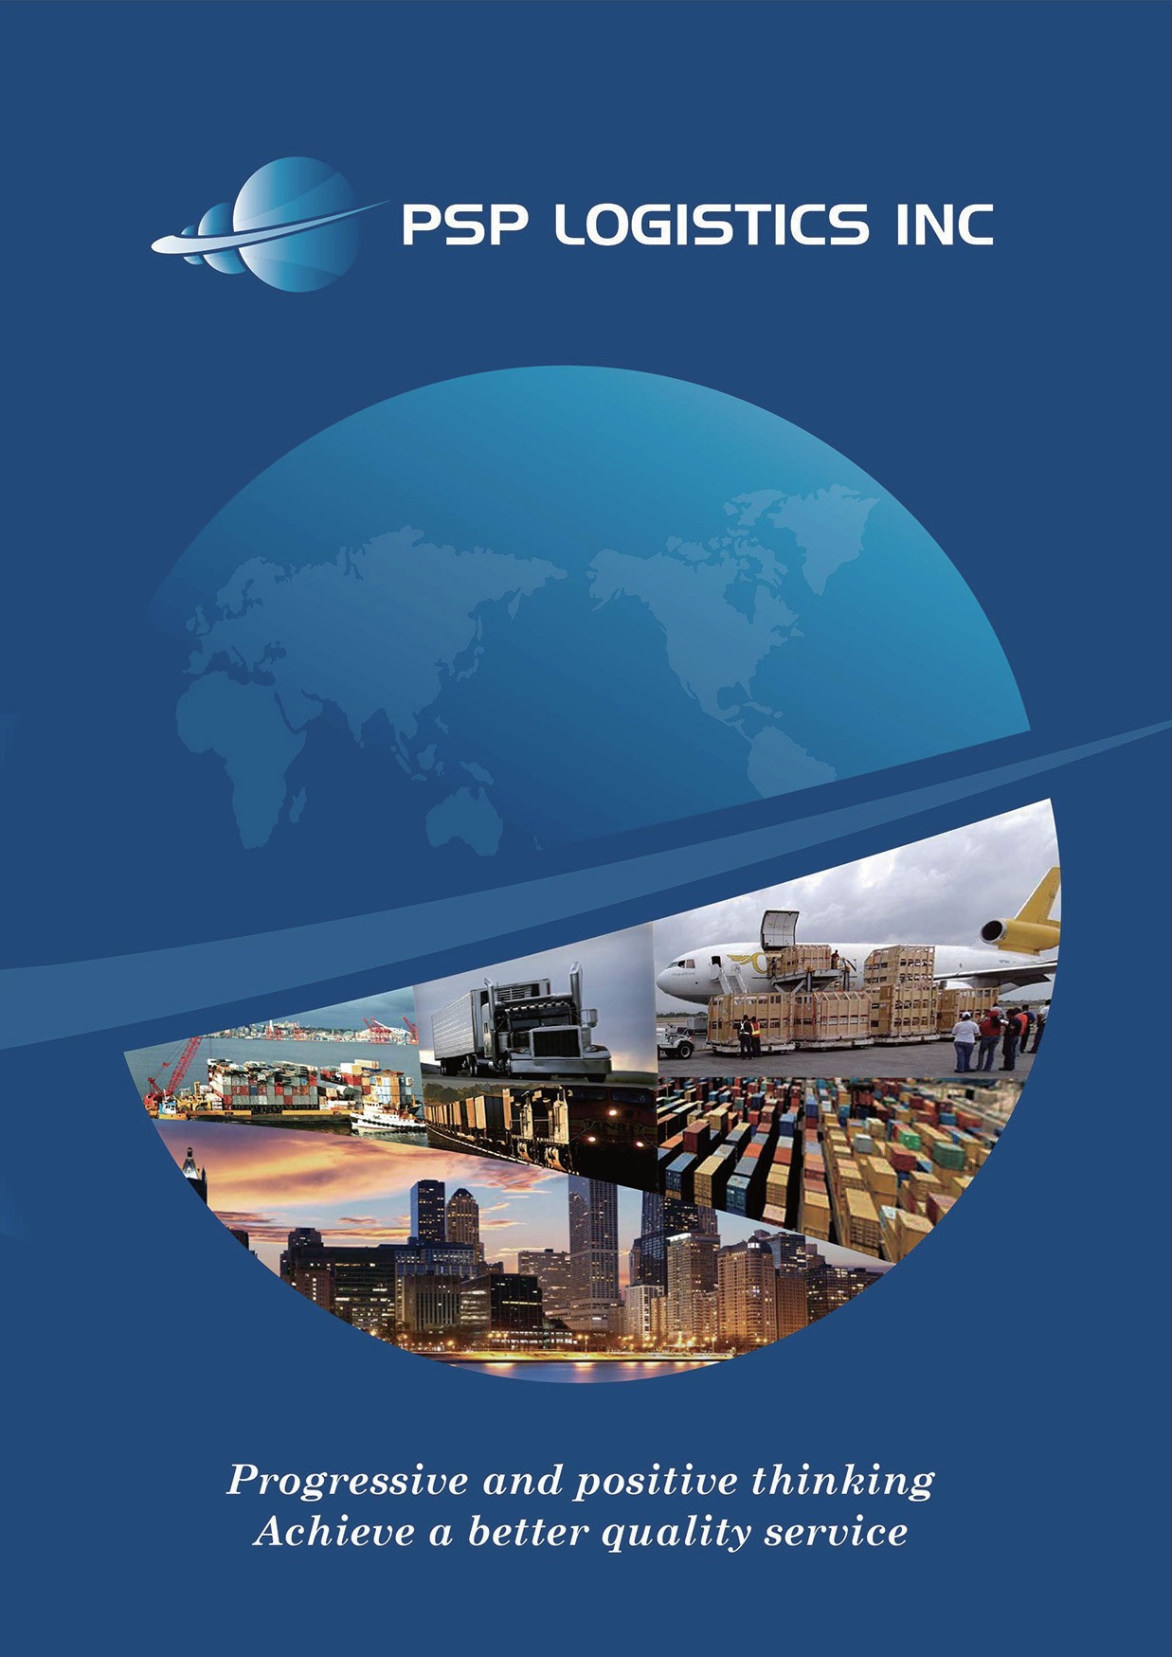

Slide 2
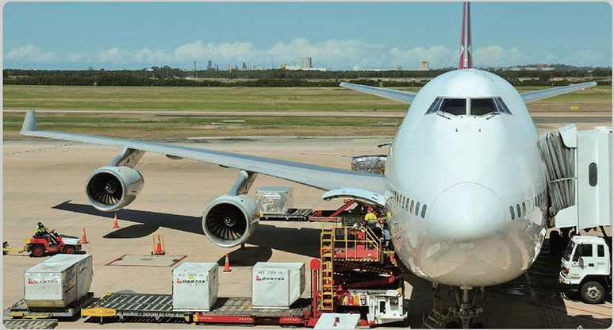

AIR FREIGHT
Import & export Including consolidations
Time definite options Incl. expedited, regular & deferred
Delivery term options incl. door to door, airport to airpor t
Proj ects
Air charter service
Comp lete U.S. & international customs clearance services
PSP LOGISTICS can provide you with a comprehensive range of import export international airfreight services We will evaluate your requirements and ensure that you and your clients receive the most effective airfreight solution.
CONSOLIDATED
To enable you to offer your customers a total service, PSP LOGISTICS can make all the arrangements
to move your goods from your ware house right through to your customers warehouse .
DOOR TO DOOR
For consignments that are more cost sensitive, We offer an extensive selection of consolidated services that ensure you receive a quality service at an affordable price.
We have a reliable network. A great track record. great pricing.
excellent customer service. Our goal is to get your cargo from point A to point Bon time
and in the same condition you sent it.
International shipping is only one of our specialties , we offer a wide array of shipping arrangements to our customers.

Slide 3
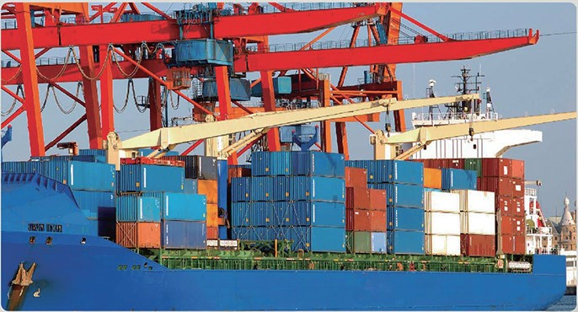
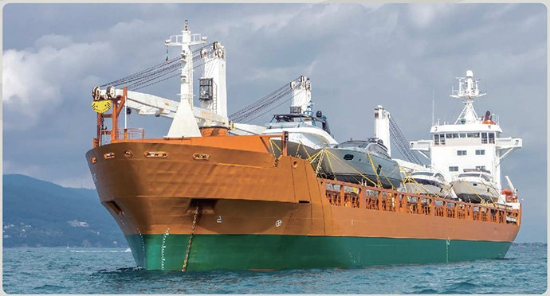
OCEAN FREIGHT
FCL (FULL CONTAINER LOADS)
Full load containers are supplied for your exclusive use door to door for each journey.
Container services are now available between most major ports around the world and PSP LOGISTICS can make all the necessary arrangements for you on a door to door basis.
Specific equipment is available to accommodate most cargo , including open top and temperature controlled containers, and for ease of loading we can deliver containers w ith special equipment to place them at ground level.
LCL(LESS THAN CONTAINER LOADS)
For consignments that are less than less than a full container load TP express is able to offer customers the benefits of consolidated cargo services between most of the major industrial centers of the world. regular containerized consolidation(LCL) services to and from most major ports.
CONVENTIONAL LINER SERVICES FOR OUTSIZE AND PROJECT LOADS BULK CARRIERS AND BARGE SERVICE

Slide 4
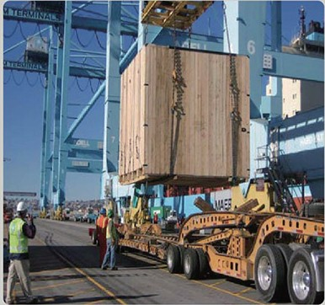
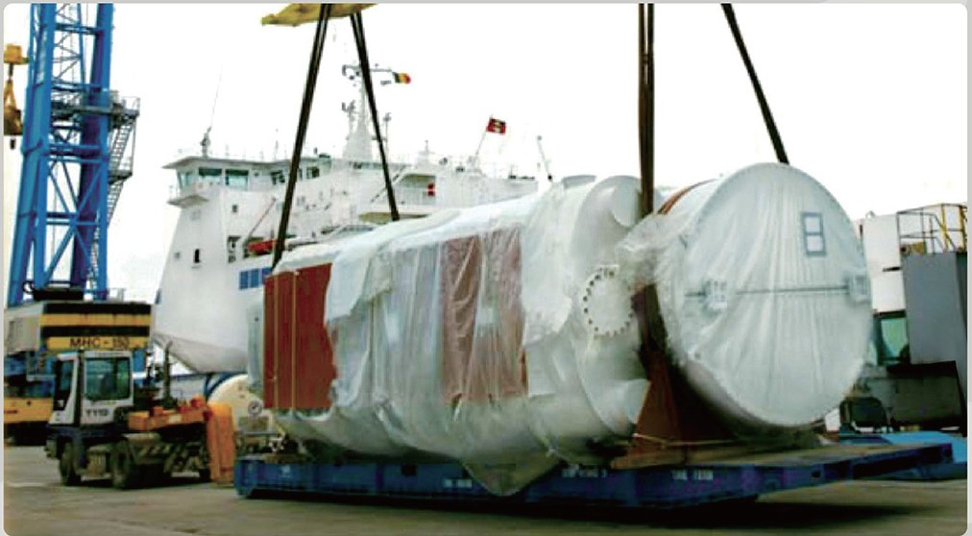
PROJECT CARGO
Regulatory & trade compliance management
Documentation processing
Surety bonds
Letters of credit
Legalization of documents
Dangerous goods
Refrigerated cargo
Personal effects
Inventory management
Multi vendor consolidation
Container stuffing and unloading
Packing & crating services
Plus chartering & more!
Monitor suppliers to def ined criteria
Call forward order and reporting
Critical path mapping
Project status reporting
Multimodal combination
Inland navigation and heavy lift
PSP LOGISTICS project services encompass the transportation, handling and control of large pieces of cargo for which the demands are much greater than for single regular movements.

Slide 5

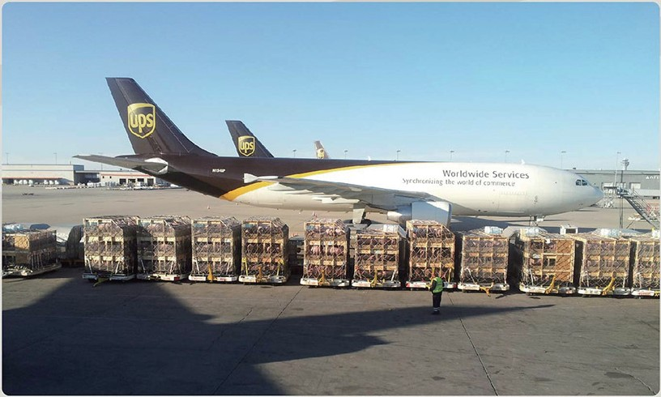
LIVESTOCK SHIPPING SERVICE
PSP LOGISTICS specializes in livestock transportat ion and provides one stop solution for all your livestock shipping needs from start to finish. We have vast experience with shipping pigs, horses, and cattle to all over the world. We build all our livestock crates to insure each crate is built with the upmost care and attention as every detail is important and crucial in building a safe and strong crate. Not only do we build the crates and transport inland, air or ocean , we also provide quarantine for blood testing and Health Certificates arrange USDA inspection and insurance. Whether its 1 crate to a full charter, 1 head to 1,000 heads, our team of live animal expertise will work hard to minimize all risks and max imize safety and wellbeing of your livestock until they reach their final destination.

Slide 6
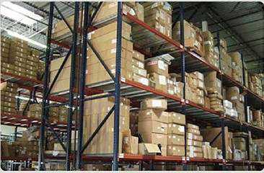
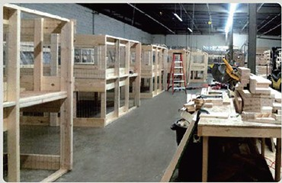
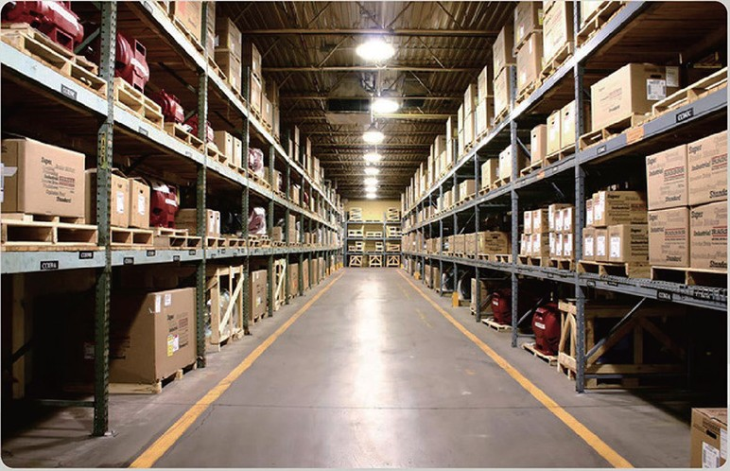
WAREHOUSING AND CRATING FACILITY
Our warehouse is equipped w ith all the tools necessary to handle your freight, We have a in house scale with a 10,000 LBS capac ity and a full set power tools and heat treated lumber for any crating need all our warehouse employees are trained to handle andy kind of freight or materials.
Live loading\unloading of ocean containers
Stripping or loading floor loaded containers
Multiple party routing of inbound consolidations
Monthly storage
Inventory management and quality control
Packaging & crating
Va lue added services upon request
Our modern facilities are equipped with the most state-of-the-art equipment for packing your items. We offer the highest level of security, including video surveillance, so you can rest assured knowing that your products will not be tampered with at our facility. Our employees are TSA-Compliant , and are trained to specific standards to maintain the highest level of workmanship. From our trained fork-lift drivers , to our craters .

Slide 7
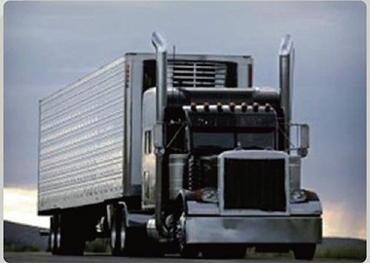
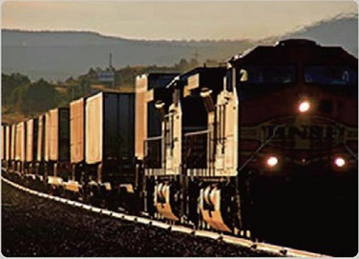
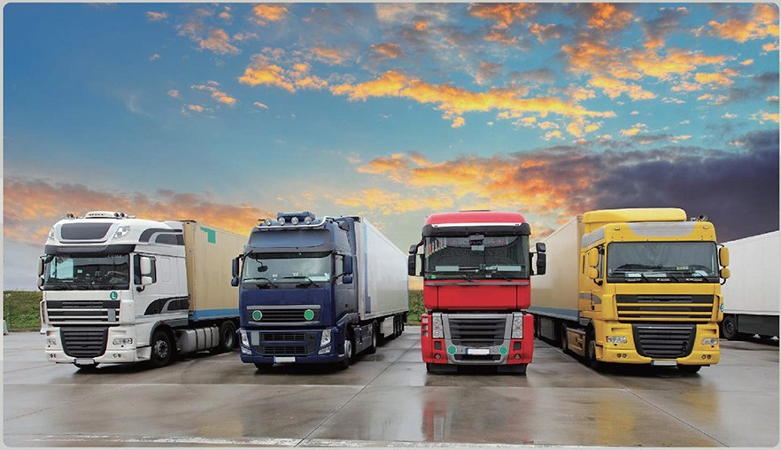
GROUND TRANSPORTATION
DOOR TO DOOR
PSP LOGISTICS can make all the arrangements to move your goods from your warehouse right
through to your custmers warehouse.
We also can provide premium harbor and rail drayage between all california piers and rail ramps. We perform timely delivery of ocean of rail containers , between your door and the ports or rail ramps of your choosing.
AIR I C.F.S. PICKUP AND DELIVERY
PSP LOGISTICS offers same day pickup and delivery to the CHI/ LAX/ NYC/ ATL metro area. We are always in contact with each truck and make certain your deliveries are on time. Our fleet of computer/ radio dispatched trucks are ready to help you. Call us when you need a reliable trucking company for local freight pickup and delivery.
PSP LOGISTICS, INC is a Certified C-TPAT Partner (

